Slide 1
Tables (oh, my)
Tutorial #19

Slide 2
OBJECTIVE

Slide 3
Objective
By the end of this tutorial, you should know how to assemble a table using HTML and how to dynamically update that table using Javascript.

Slide 4
TEXTPLANATION

Slide 5
Textplanation
Tables are another construct that’s built by combining several tags together. They are used for pages that need to display data in an organized manner.

Slide 6
Textplanation
At the top of the food chain is the <table></table> tag. Like a list, this is the container tag. The hardest part about putting a table together is building columns and rows using code that just heads down the screen. The HTML gods decided that we should all work in rows and that the columns would get built naturally. I guess they figured that most tables are built down, which makes sense, but when you’re building one across, the coding gets tough.

Slide 7
Textplanation
We started with the <table> tag. Inside the <table> tag, you have to create rows using the <tr></tr> tag. The tr stands for “table row”. You’d already figured that out, though, didn’t you?

Slide 8
Textplanation
The <tr></tr> tag is also a container. So a table has containers inside a container. It’s necessary. Trust me. Each time you add one of those to your table, you’re adding a row.

Slide 9
Textplanation
The next step is to add cells to the rows. The tag for adding a table cell is <td></td>. Go ahead and figure out what that stand for.

Slide 10
Textplanation
It stands for table data.

Slide 11
Textplanation
If you create 3 rows and put 4 cells into each row, those cells will line up into columns. Columns are never created as columns. Instead, it’s up to the browser to align the cells in the rows and create columns that way. It works fine until you start creating uneven rows. Then, you’re thinking you want cell B in row 4 to line up with cell C in row 3 and the browser just isn’t having it. But, as a clever programmer, you’ll soon learn to navigate this jungle and create beautiful and useful tables.

Slide 12
Textplanation
You can also manipulate tables dynamically, which is really important because the percentage of time that your data is fixed and you can set it up statically is less than 1%. Data comes from databases that are stored on servers and are constantly being updated. Data comes from users who are terrible, vandalous creatures who will do anything to mess up you page. Data comes from anywhere and everywhere, but it only rarely comes from your code.

Slide 13
Textplanation
If you want to work with your table, you can grab it the same way you grab a div for using the innerHTML. The table object has a function called addRow(), which adds and returns a new row as an object. The row object has a function called addCell(), which add and returns a new cell as an object. Then you can just add data to the cell.

Slide 14
Textplanation
The key here is knowing, understanding, and controlling the format of your data.

Slide 15
CONSTRUCTION

Slide 16
Construction #1
Create a folder somewhere on your drive and label it Tables
Open up notepad++.
Save the empty file to your folder and name the file “index.html”.
All first pages on a website are called index.
As you go through the images of the construction, add to your code. You will see comments with explanations of what you are doing. Those comments will change with each slide. You should not type my comments into your code.

Slide 17
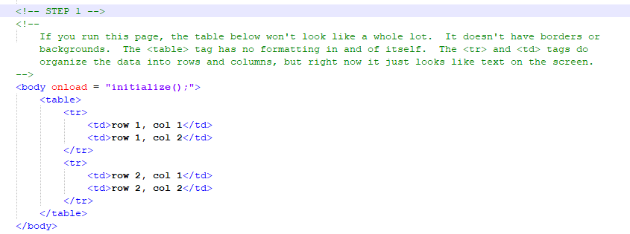
Construction #1

Slide 18
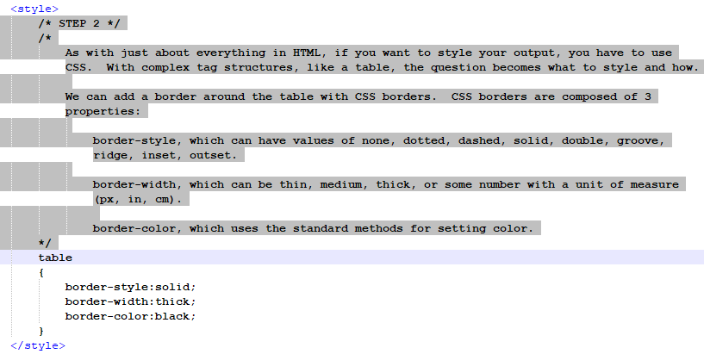
Construction #1

Slide 19
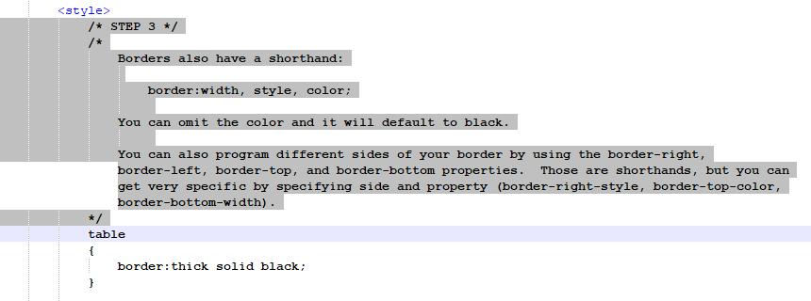
Construction #1

Slide 20
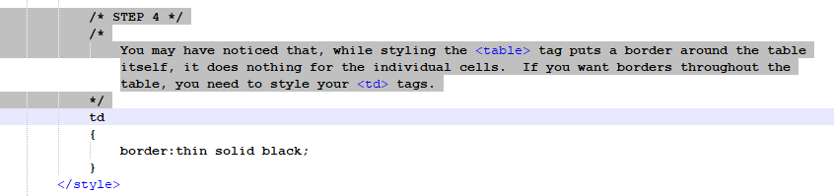
Construction #1

Slide 21
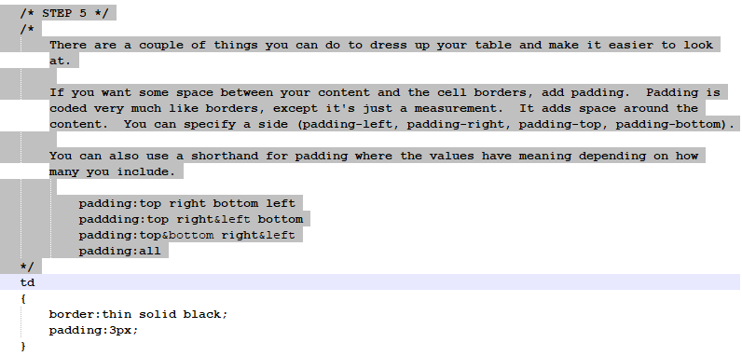
Construction #1

Slide 22
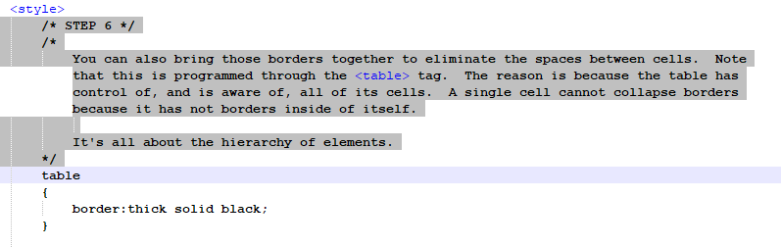
Construction #1

Slide 23
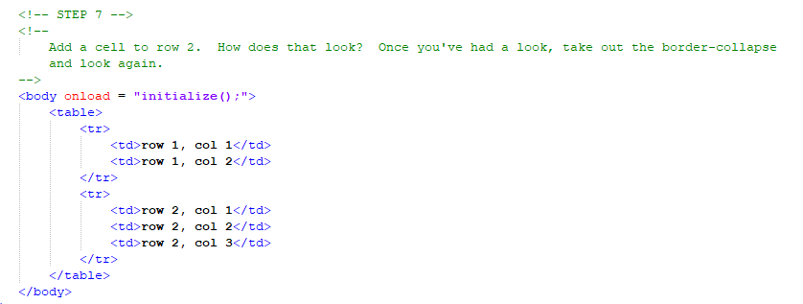
Construction #1

Slide 24
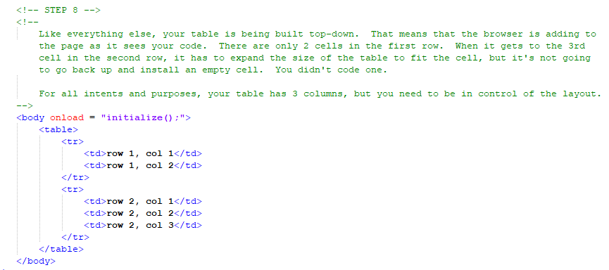
Construction #1

Slide 25
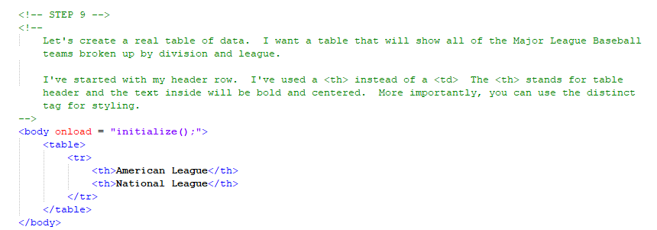
Construction #1

Slide 26
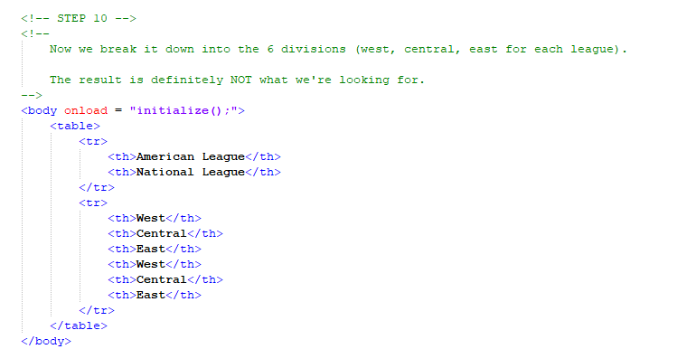
Construction #1

Slide 27
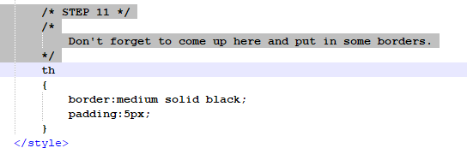
Construction #1

Slide 28
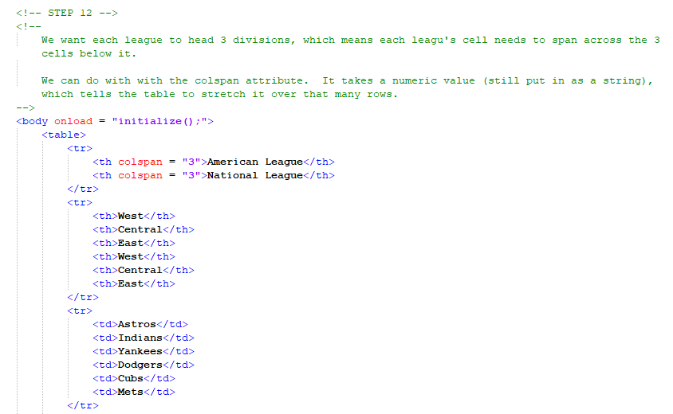
Construction #1

Slide 29
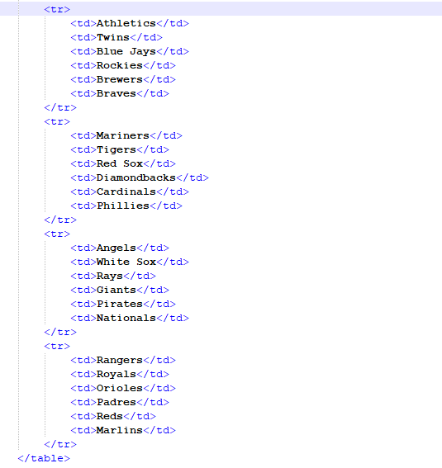

Slide 30
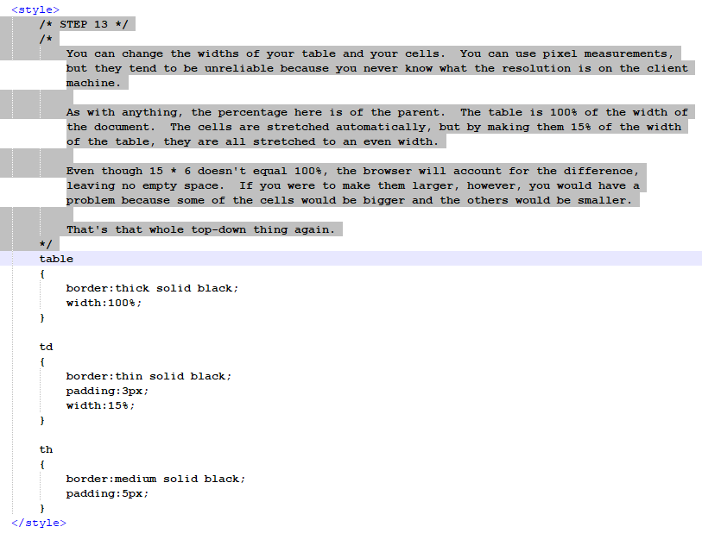

Slide 31
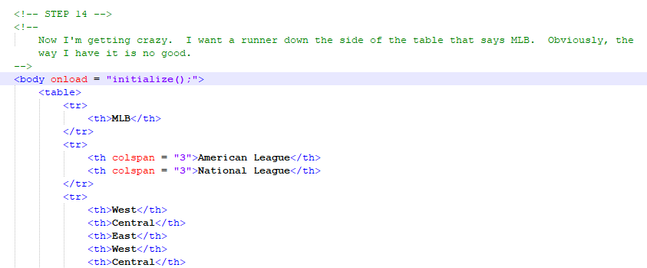
Construction #1

Slide 32
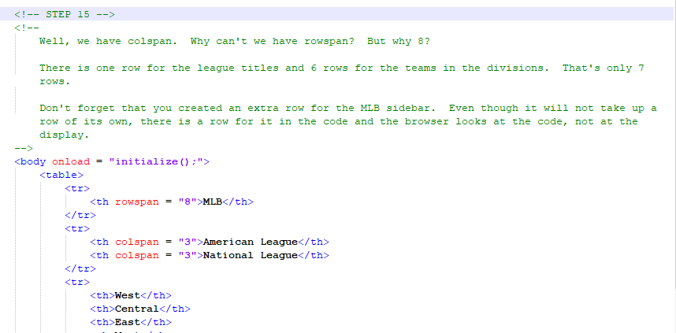
Construction #1

Slide 33
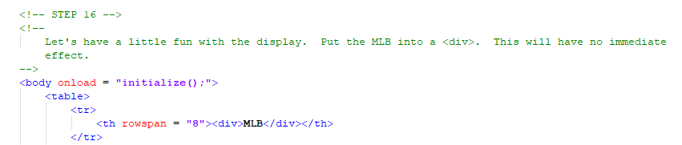
Construction #1

Slide 34
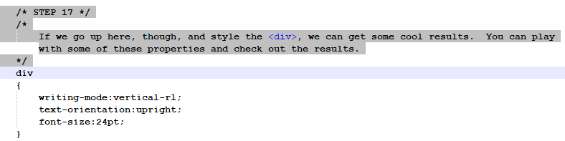
Construction #1

Slide 35
Construction #2
Create a folder somewhere on your drive and label it Dynamic Tables
Open up notepad++.
Save the empty file to your folder and name the file “index.html”.
All first pages on a website are called index.
As you go through the images of the construction, add to your code. You will see comments with explanations of what you are doing. Those comments will change with each slide. You should not type my comments into your code.

Slide 36
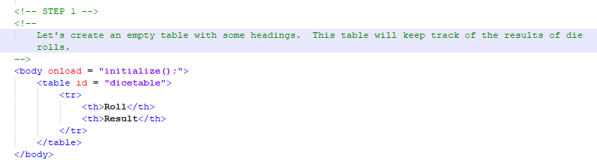
Construction #2

Slide 37
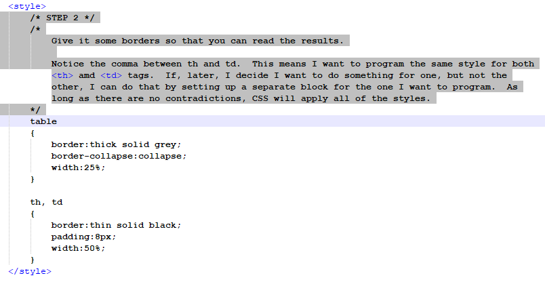
Construction #2

Slide 38
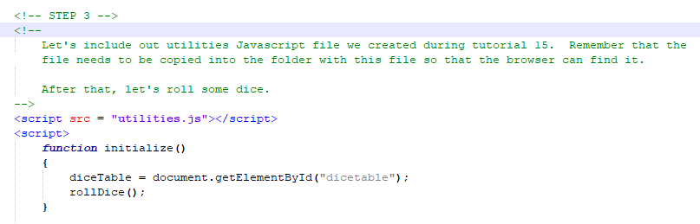
Construction #2

Slide 39
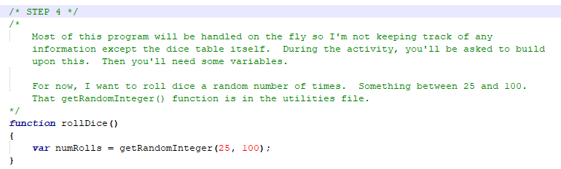
Construction #2

Slide 40
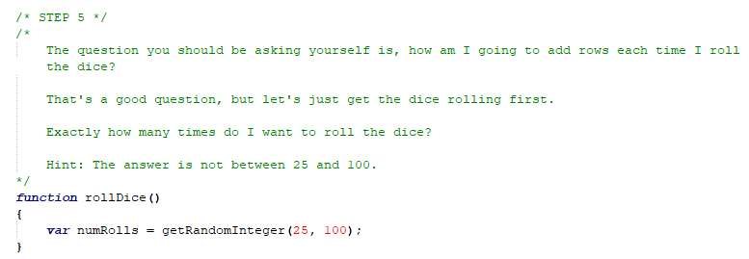
Construction #2

Slide 41
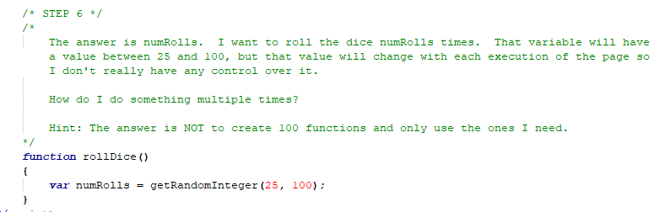
Construction #2

Slide 42
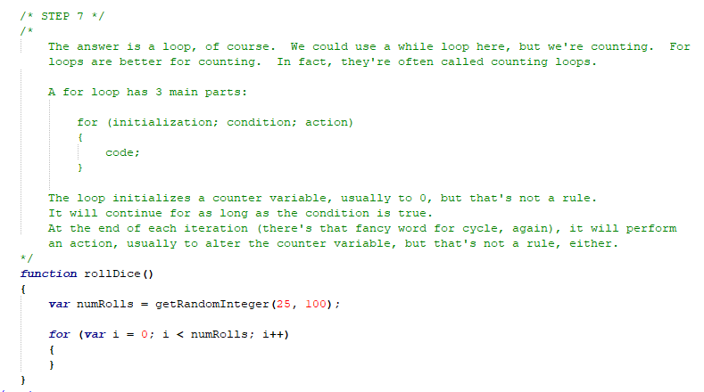
Construction #2

Slide 43
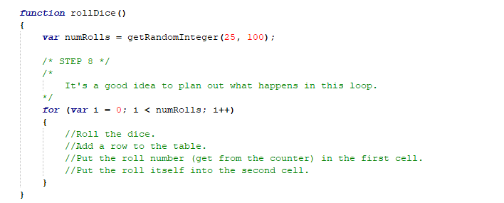
Construction #2

Slide 44
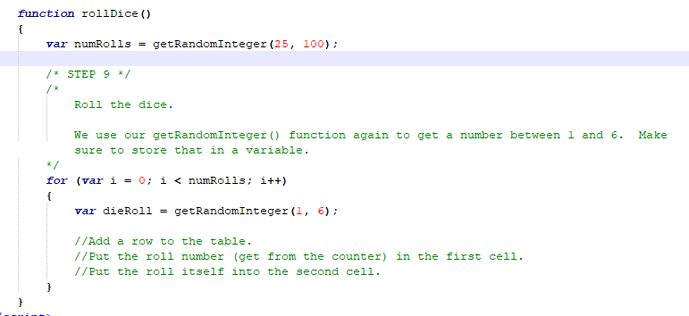
Construction #2

Slide 45
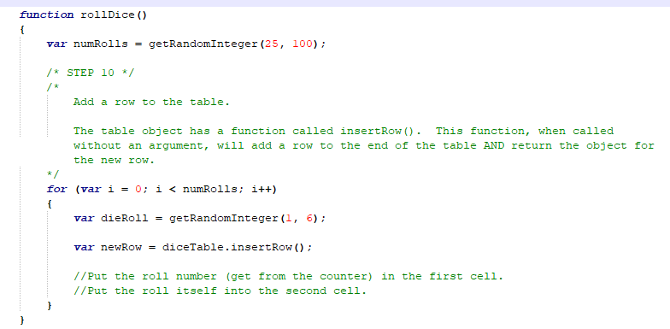
Construction #2

Slide 46
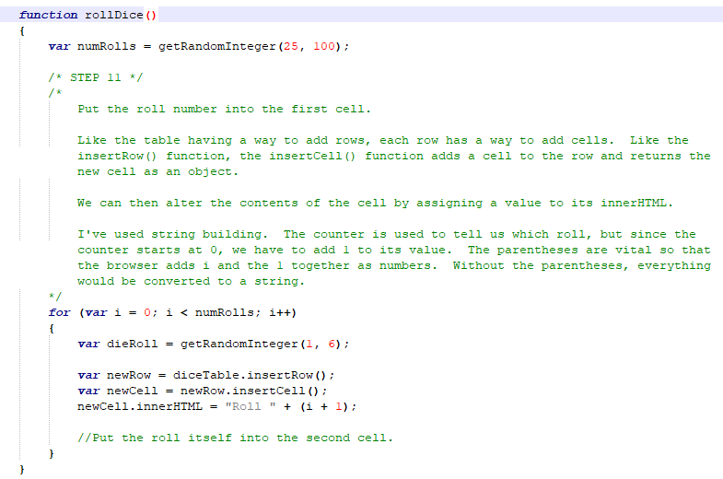
Construction #2

Slide 47
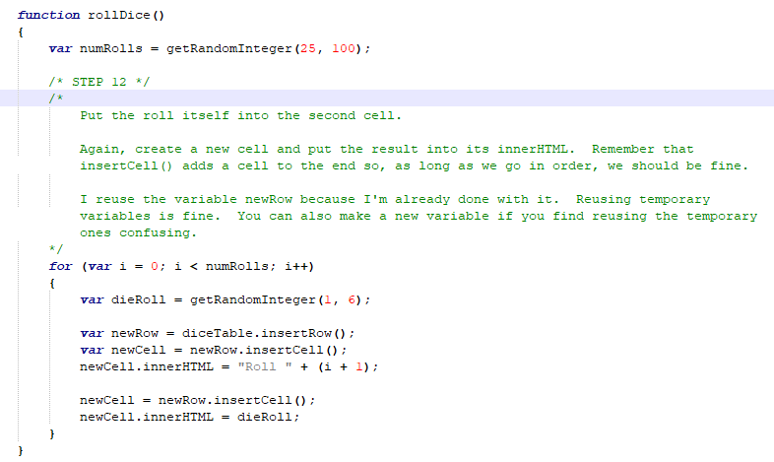
Construction #2

Slide 48
A DEEPER MEANING

Slide 49
A Deeper Meaning
Tables are for data.

Slide 50
A Deeper Meaning
Way back in prehistoric times, before CSS became the norm, cavemen used to organize their web pages using tables. Table design was all the rage back then, but quickly fell out of favor as CSS provided better functionality.

Slide 51
A Deeper Meaning
When designing your page using tables, things can get really complicated. You need tables inside of tables inside of tables. It’s an ugly affair that confuses humans and puts extra stress on processors. Don’t do it.

Slide 52
A Deeper Meaning
Ever.

Slide 53
A Deeper Meaning
Tables are for data.

Slide 54
A Deeper Meaning
Do great things with your table data.

Slide 55
FAQ

Slide 56
FAQ
Questions?
No.

Slide 57
ACTIVITY

Slide 58
Dice Table
Expand the dice table.
Base the number of results on user input instead of making them random.
As the results are calculated and added to the table, keep a running total of each result (number of times each result has been rolled) and add that to the row.
At the bottom of the table, list the mean, median, and mode of all of the rolls.

Slide 59
Level 2
You are now ready to take on a Level 2 project. Please choose one of the spec sheets (or create your own) and have it approved. Good luck!

